Slide 1

Western Minnesota
Hannah DeBruin
Weekly Meeting: Transit Data Subgroup
03/09/23

Slide 2
Survey Response #s – Validity Filters
Transit Agency: | All Qualtrics | Proposed Filter | Paper | Combination | NTD Monthly Avg Ridership
Central Community Transit (CCT) | 197 | 119 | 21 | 140 | 17797
City of Morris Transit | 278 | 121 | 1 | 122 | 4278
None of the above | 5 | 1 | 1 | 2
Prairie Five Rides | 22 | 5 | 29 | 34 | 11242
Transit Alternatives | 215 | 106 | 12 | 118 | 7626
Tri-Cap Transit Connection | 176 | 112 | 10 | 122 | 10460
United Community Transit | 44 | 10 | 1 | 11 | 14384
Weekly Meeting (03/28/2023)
2
Hannah DeBruin

Slide 3
Survey Response #s – Validity Filters

Slide 4
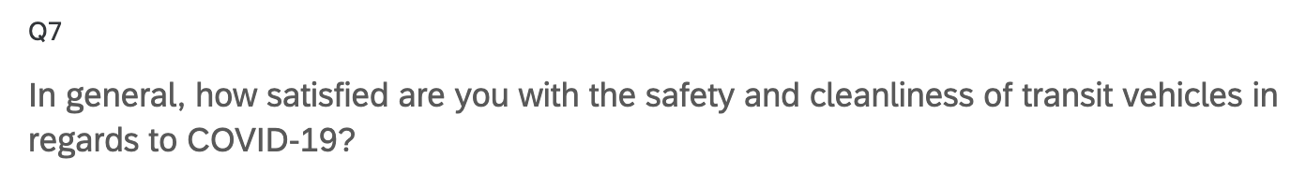
Filter Comparisons – Q7

Slide 5
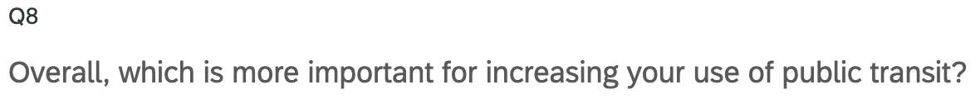
Filter Comparisons – Q8

Slide 6
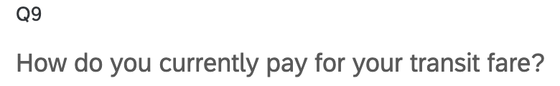
Filter Comparisons – Q9

Slide 7
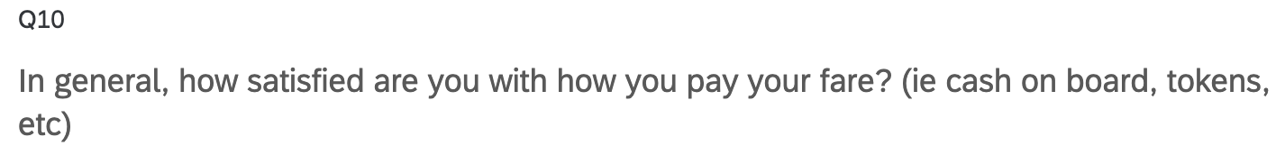
Filter Comparisons – Q10

Slide 8
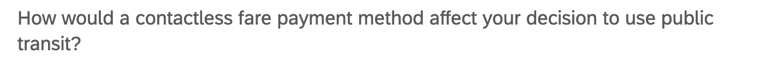
Filter Comparisons – Q11

Slide 9
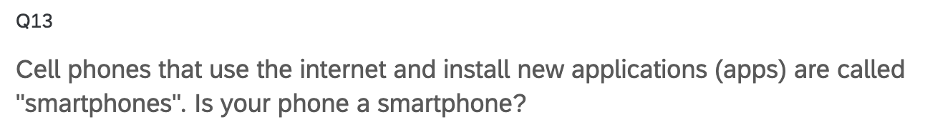
Filter Comparisons – Q13

Slide 10
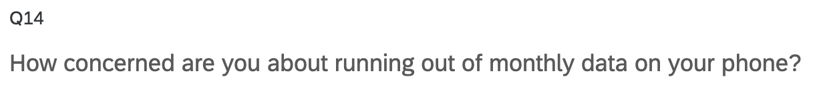
Filter Comparisons – Q14

Slide 11
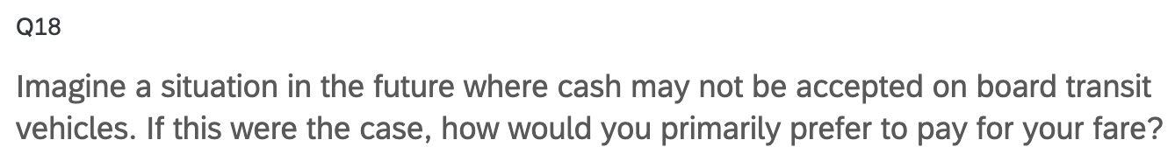
Filter Comparisons – Q18

Slide 12
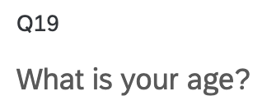
Filter Comparisons – Q19

Slide 13
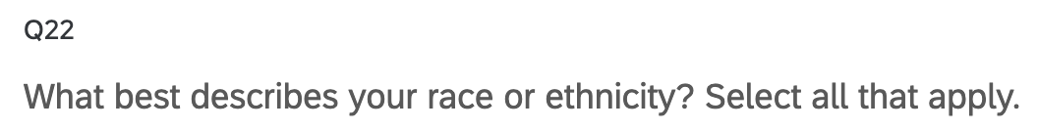
Filter Comparisons – Q22

Slide 14
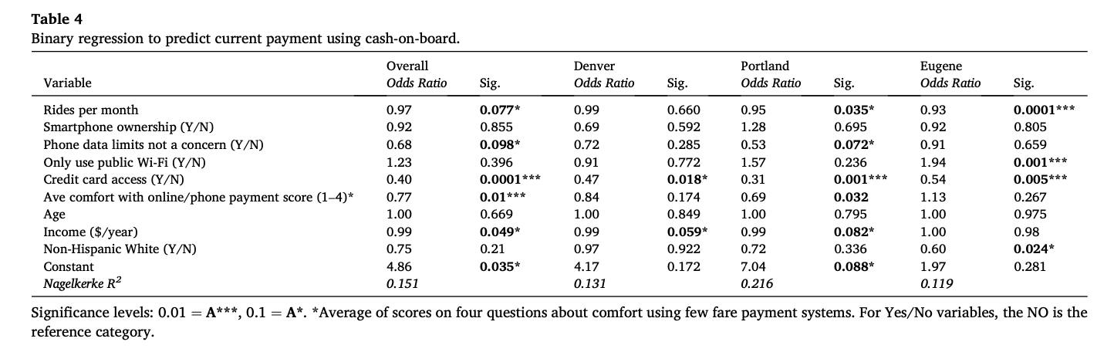
Analysis Plan
Define variables accordingly (ie binary/categorical or continuous, X or Y)
Choose statistical modeling methods to try, likely using R “glm” function
Binary logistic regression most common in literature
Look at generated coefficients of model(s), choose one with lowest adjusted R^2 error, look at significance level (t-score)
Example output table:
Weekly Meeting (03/28/2023)
Hannah DeBruin

Slide 15
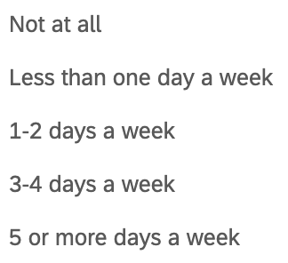
Variables Defined
Survey Question | Variable | Definition
q2 | agency | Categorical (dummy variables for each of the six agencies)
q3 | pre_covid
q4 | during_covid
q5 | present
q6 | preferred
= 0
“rides per month” evaluated in Golub_et_al as continuous
= 1
binary variables for three different levels of frequency evaluated in Brakewood and Kocur
= 2
= 3
exclude
= 5
Weekly Meeting (03/28/2023)
Hannah DeBruin

Slide 16
Variables Defined
Survey Question | Variable | Definition
q2 | agency | Categorical (dummy variables for each of the six agencies)
q3 | pre_covid
q4 | during_covid
q5 | present
q6 | preferred
q3 q4 comparison | pre_during | 1 if used more pre-covid than during, -1 if used less pre-covid than during, 0 if same alternatively: define continuously as (during_covid/pre_covid) ie 2/5 = 0.4
q4 q5 comparison | during_present | 1 if used more during covid than now, -1 if used less during than now, 0 if same alternatively: define continuously as (present/during_covid) ie 5/2 = 2.5
q5 q6 comparison | present_preferred | 1 if used more now than preferred, -1 if used less now than preferred, 0 if same alternatively: define continuously as (preferred/present) ie 5/5 = 1
q3 q5 comparison | pre_present | 1 if used more pre-covid than now, -1 if used less pre-covid than now, 0 if same alternatively: define continuously as (present/pre_covid) ie 5/5 = 1
= 0
“rides per month” evaluated in Golub_et_al as continuous
= 1
binary variables for three different levels of frequency evaluated in Brakewood and Kocur
= 2
= 3
exclude
= 5
Weekly Meeting (03/28/2023)
Hannah DeBruin

Slide 17
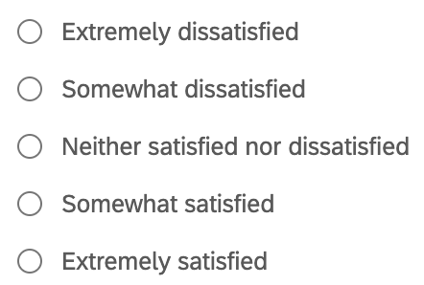
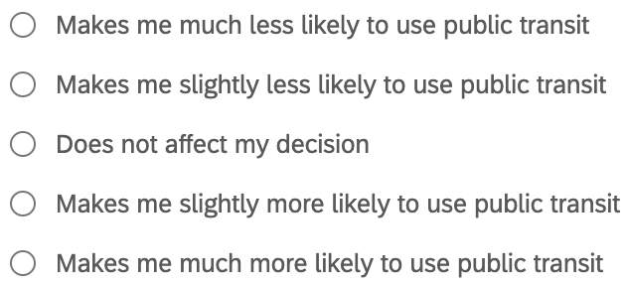
Variables Defined
Survey Question | Variable | Definition
q2 | agency | Categorical (dummy variables for each of the six agencies)
q3 | pre_covid
q4 | during_covid
q5 | present
q6 | preferred
q7 | covid_satisfaction
q10 | fare_satisfaction
q11 | contactless_attitude
q12 | trip_planning_attitude
= 0
“rides per month” evaluated in Golub_et_al as continuous
= 1
binary variables for three different levels of frequency evaluated in Brakewood and Kocur
= 2
= 3
exclude
= 5
= -2
0
= -1
excluded
= 0
= 1
= 2
1
= -2
= -1
was not evaluated in either study
= 0
= 1
= 2
Weekly Meeting (03/28/2023)
Hannah DeBruin

Slide 18
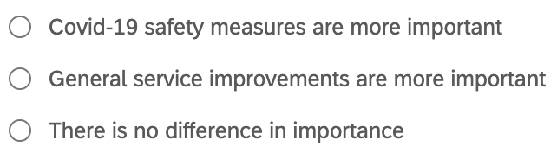
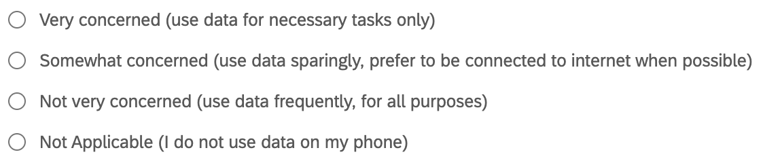
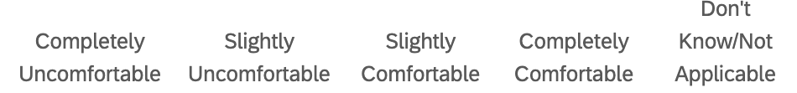
Variables Defined
Survey Question | Variable | Definition
q8 | more_important
q9 | fare_type | Categorical (dummy variables for each of the five current payment types)
q13 | cell_phone | 1 for yes I have a smartphone, 0 for no (I don’t have a smartphone, a cell phone)
q14 | data
q15 | internet | Categorical (dummy variables for each of the five internet access types)
q16 | payment | Categorical (dummy variables for each of the six current payment types)
q17_1 | once_website
q17_2 | regular_website
q17_3 | regular_app
q17_4 | once_phonecall
q_18 | noncash_alternative | Categorical (dummy variables for each of the four payment alternative options)
= 1
= -1
or dummy variables for each?
= 0
= 3
values 1-4
evaluated in Golub_et_al
= 2
= 1
exclude
values 1-4
evaluated in Golub_et_al
= -2
= -1
= 1
= 2
exclude

Slide 19
Variables Defined
Survey Question | Variable | Definition
q19 | age | Categorical (dummy variables for each of the six age ranges) Alternatively, continuous with the floor of each range?
q20 | zipcode | Continuous
q21 | disability | Binary 1=disabled, 0=able-bodied
q22 | race | Categorical (dummy variables for each of the seven races)
q23 | gender | Categorical (dummy variables for each of the four options)

Slide 20
Survey Objectives Summarized
Transit usage/behavior, and return post-COVID
Attitudes about transit quality of service
Attitudes about transit COVID safety
Attitudes about fare payment
Attitudes about trip planning
Model relationship with Y= covid_satisfaction, fare_satisfaction, the four frequency comparisons, contactless_attitude, trip_planning_attitude
Weekly Meeting (03/28/2023)
Hannah DeBruin

Slide 21
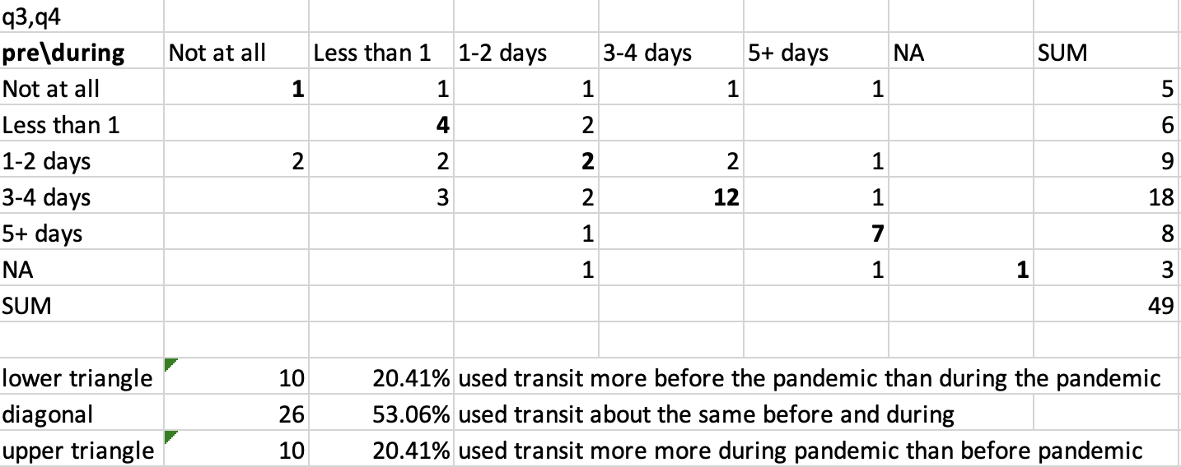
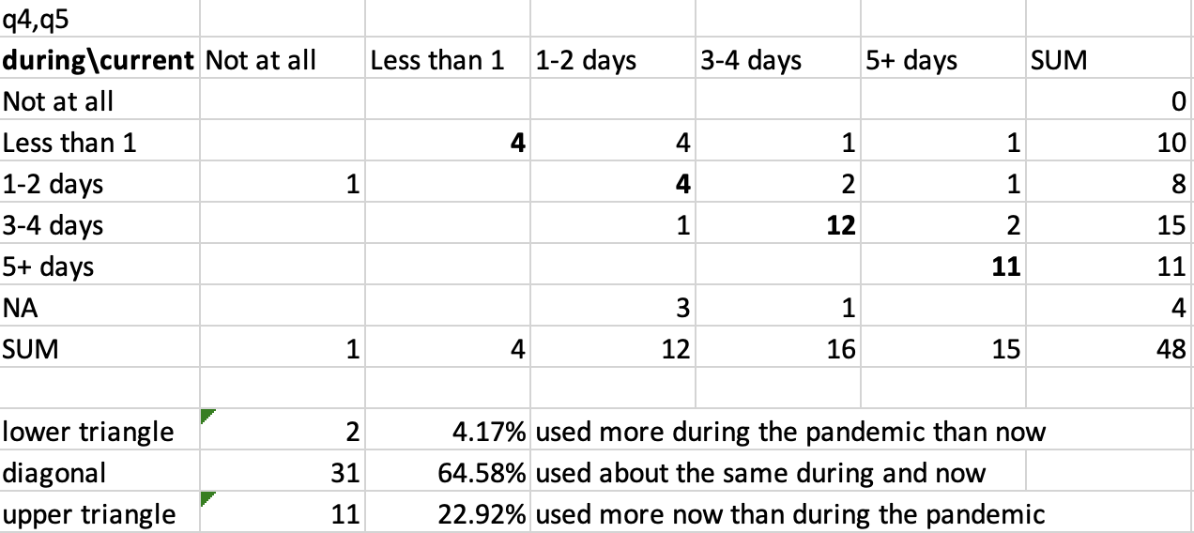
Transit Usage/Behavior and Return post-Covid
Pre-Pandemic v During Pandemic
During Pandemic v Now
Weekly Meeting (03/09/2023)
Hannah DeBruin

Slide 22
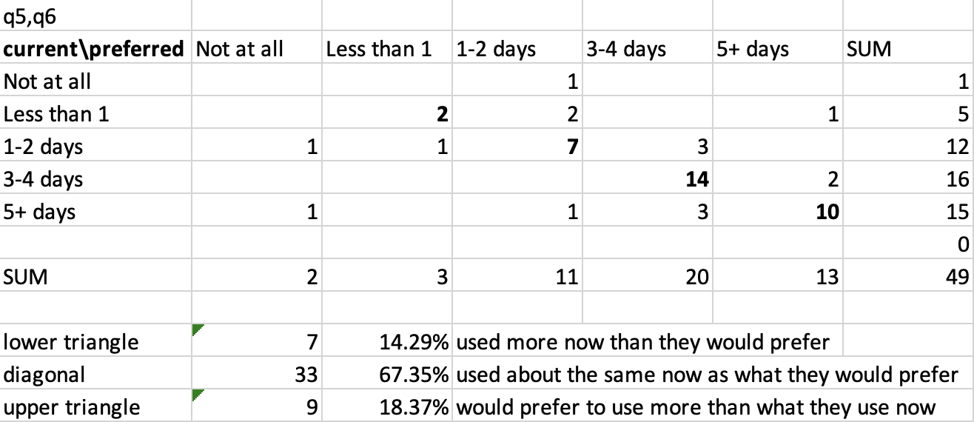
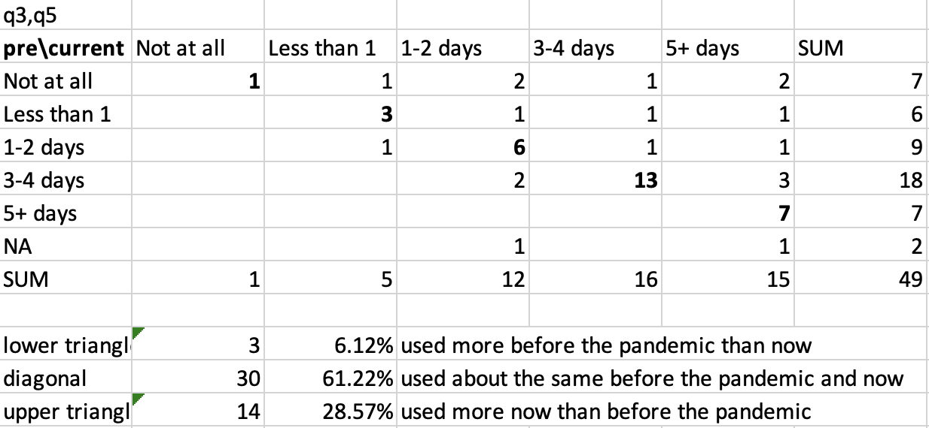
Transit Usage/Behavior and Return post-Covid
Current v Preferred
Pre-Pandemic v Now
Weekly Meeting (03/09/2023)
Hannah DeBruin

Slide 23
Potential Analysis
Inside Scope of Work:
Satisfaction with fare payment by current fare payment method
Satisfaction with fare payment compared with interest in contactless fare payment
Capabilities for contactless fare payment (ie smartphone, data, payment options) compared with interest in contactless fare payment
Strength of return to transit (frequency of transit use) compared to satisfaction with COVID-19 safety/cleanliness
Strength of return to transit (frequency of transit use) compared to satisfaction with fare payment
Probably don’t want to analyze attitudes specific to a transit provider because of small response rates for some agencies
Could analyze sociodemographic information (ie age, disability, gender, race/ethnicity) compared with attitudes, strength of return to transit (frequency of transit use)
Outside Scope of Work:
Weekly Meeting (03/09/2023)
Hannah DeBruin

